Slide 1
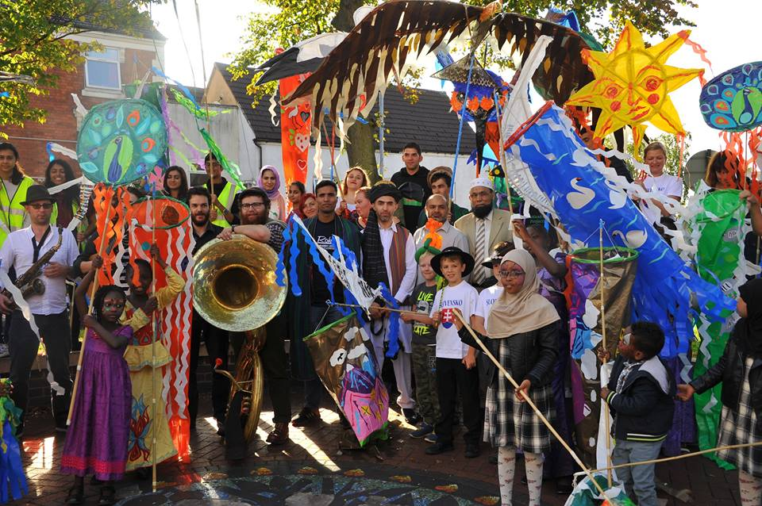
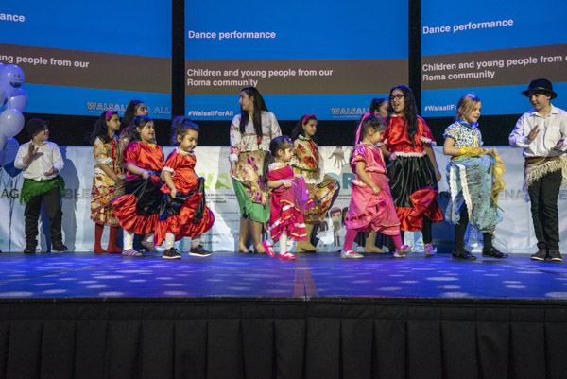
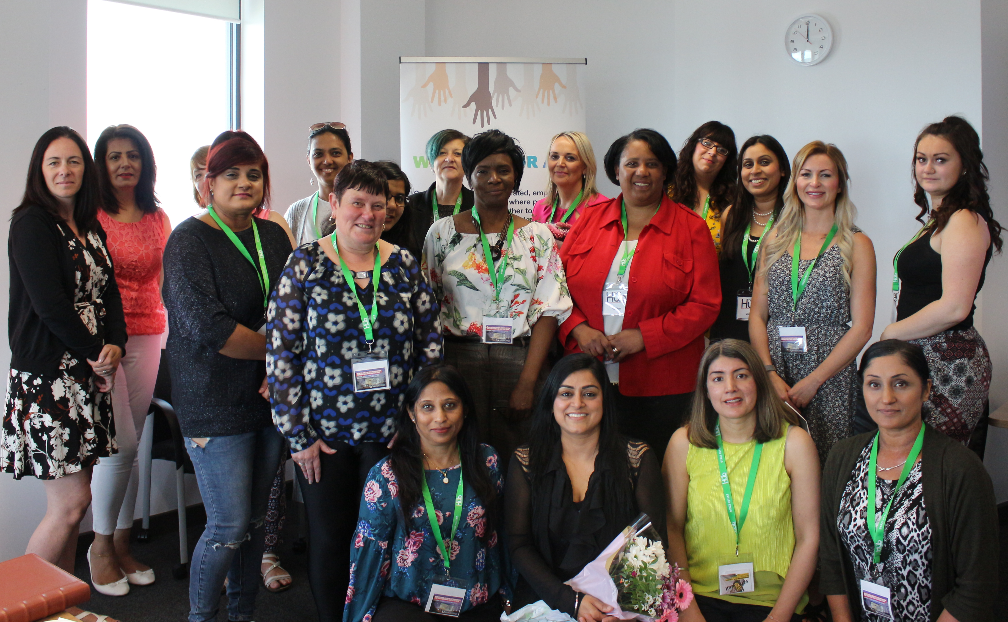
Overview of Walsall for All Partnership
A’isha Khan, Chair W4A Partnership
Dr Irena Hergottova, Walsall Council

Slide 2
Context
Walsall Council
Community Cohesion and Integration Strategy 2018
Covid-19 Pandemic 2020
Resilient Communities & Resetting Agenda
2021-
Government Integrated Communities Strategy 2019

Slide 3
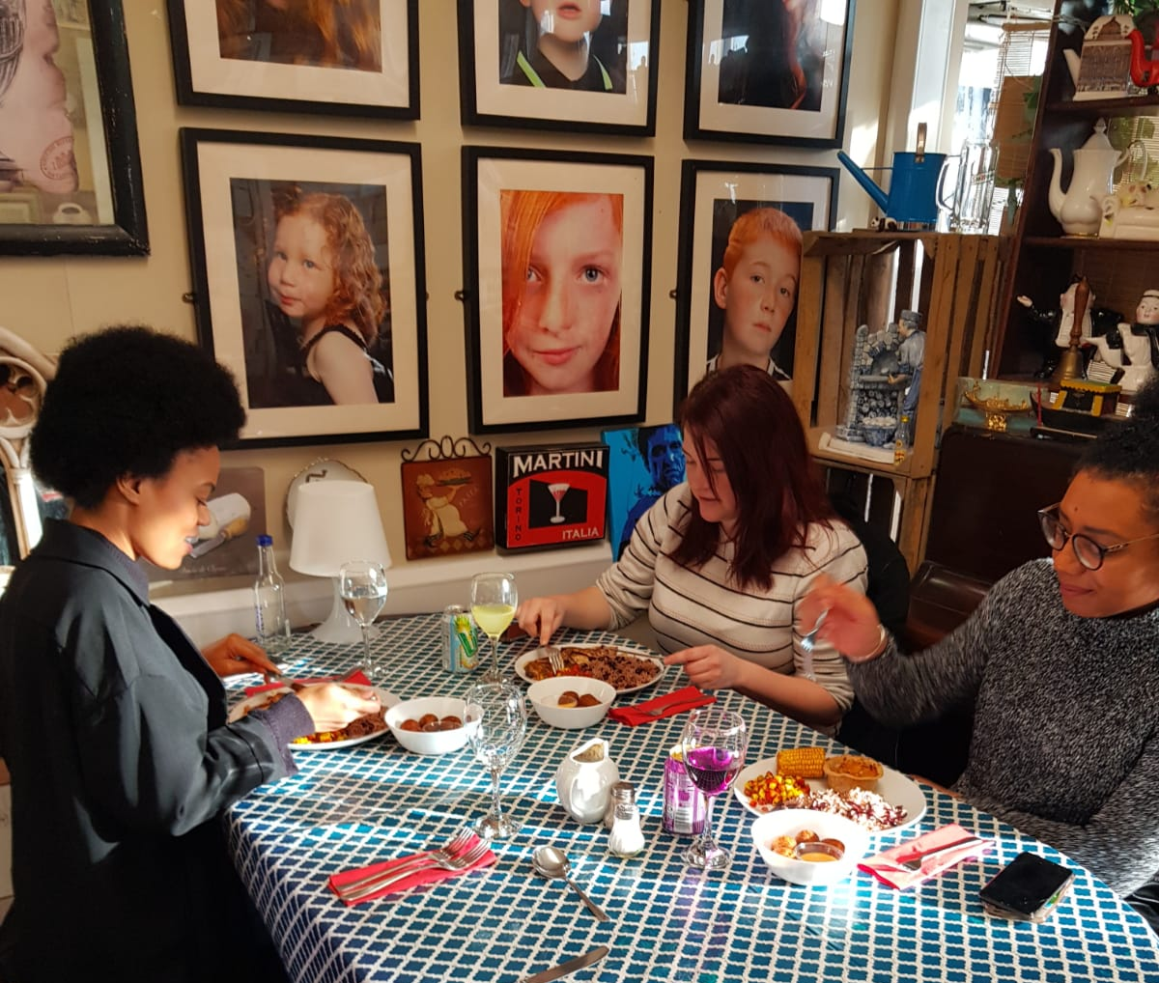
Vision
Our vision is to create integrated, empowered and inclusive communities where people from all backgrounds come together to celebrate what they have in common. A place where our residents are safe and valued, and everyone has fair opportunities to fulfil their potential and contribute to the growth of Walsall.
Connecting across communities
Young people learning and growing together
Working and contributing together
Living together
Notes:
It recognises our strengths as well as our challenges, and sets out the steps we will take to break down barriers to integration.

Slide 4
Evaluation

Slide 5
Achievements

Slide 6
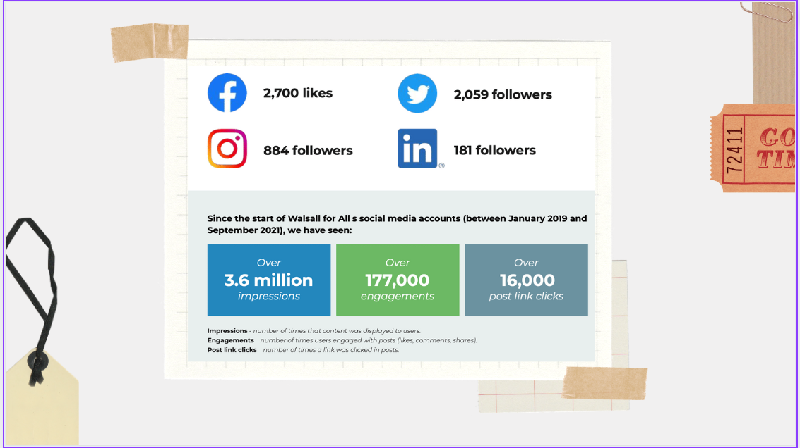
Social Media

Slide 7
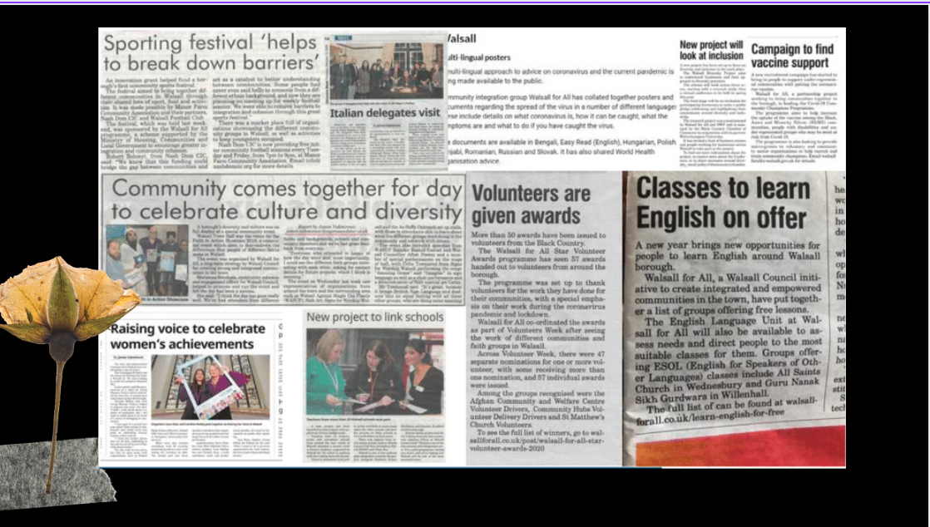

Slide 8
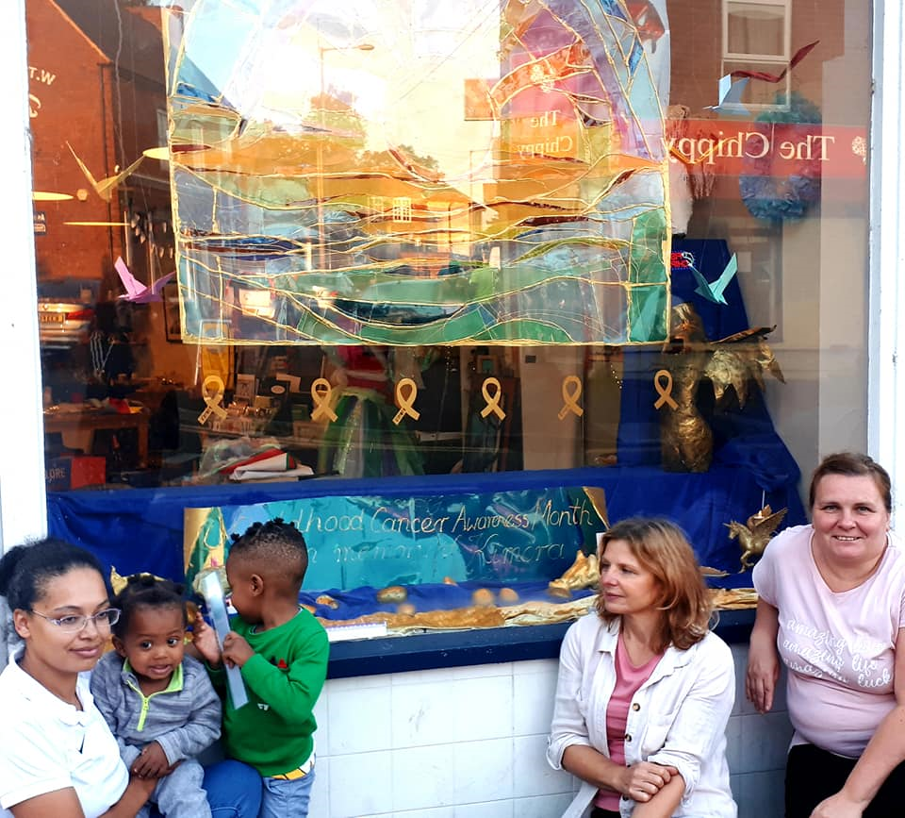
Testimonies from Participants
YouTube video (youtubetrimmer.com)

Slide 10
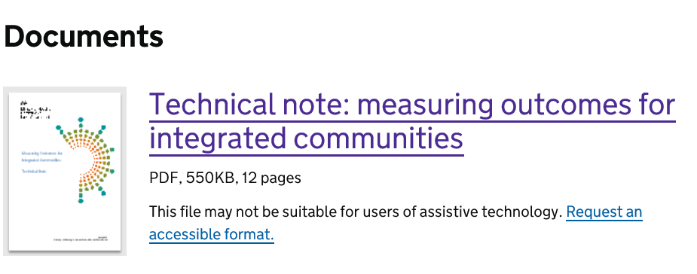
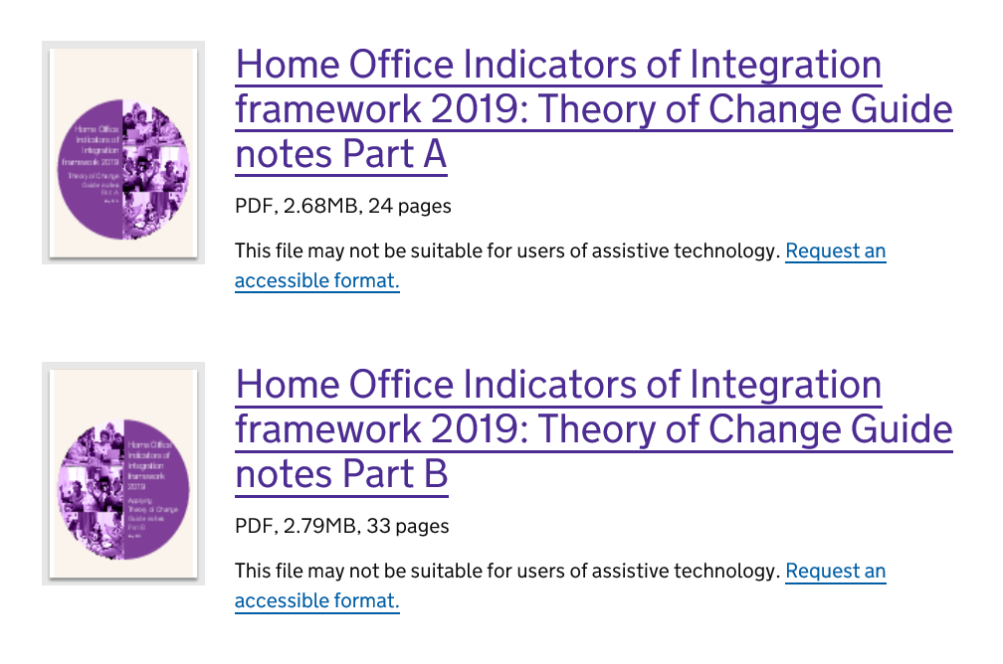
INDICATOR | Intervention or Research
Sharing a common language | ESOL in the community
Social mixing | School linking, volunteering
Social cohesion | Beyond Us and Them
Social capital | Shared prosperity fund?
Economic activity | DWP Women Empowerment
Social Isolation | Resilient Communities model
Hate Crime | Ambassadors
Educational attainment | Need more prioritisation
Adult education | Need better partnerships
Residential segregation | Need a long-term view

Slide 11
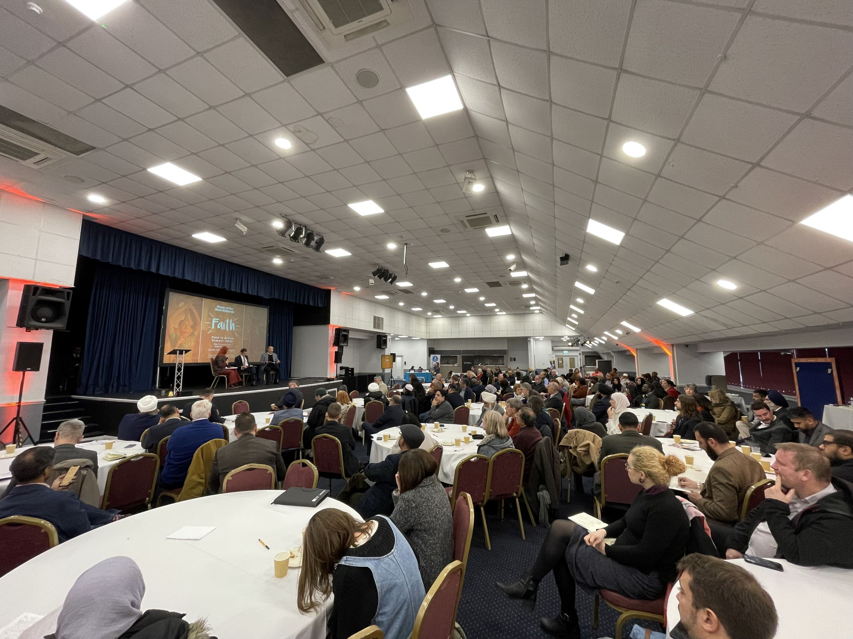
New Opportunities at WMCA level
WMCA Race Equality Task Force
Faith in Action
Faith Strategic Partnership
Group
Cost of living discussions

Slide 12
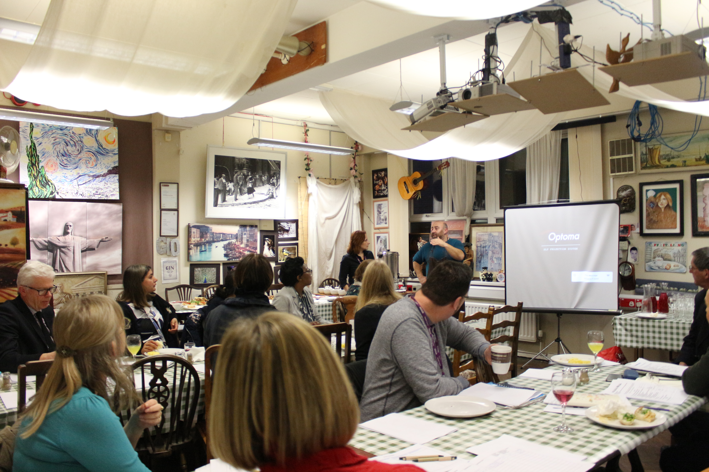
Partnership Board and Resilient Communities
Word from the Walsall for All Chair – A’isha Khan
Representing diverse voices
Learning from best practice
Consultation vehicle
Influencer
Fair outcomes
Equality and human right laws
Cultural advisors
Membership and governance

Slide 13
How can you get involved?
Social Media
Email: walsallforall@walsall.gov.uk
Website: https://www.walsallforall.co.uk/

